Slide 1

MALLA REDDY COLLEGE OF ENGINEERING & TECHNOLOGY
Department of Aeronautical Engineering
MINI PROJECT
Design and Analysis of Propulsion System using AIML algorithms of a Gesture Control UAV with an integrated IOT Components
Under the Guidance of Presented by: Batch No: 12
Mr. M. YUGENDER SHAIK NAWAZ (20N31A2134)
Associate Professor TIRUMALA SAI NITHIN (20N31A2135)
V.HIMABINDU (20N31A2136)

Slide 2
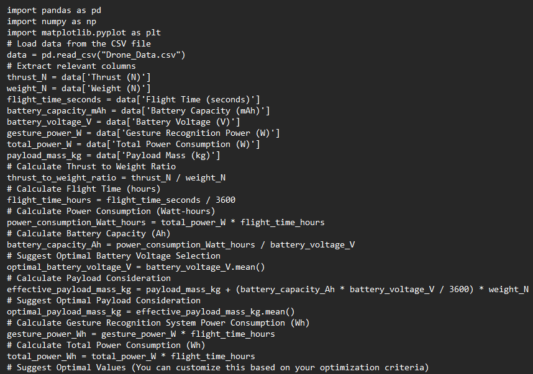
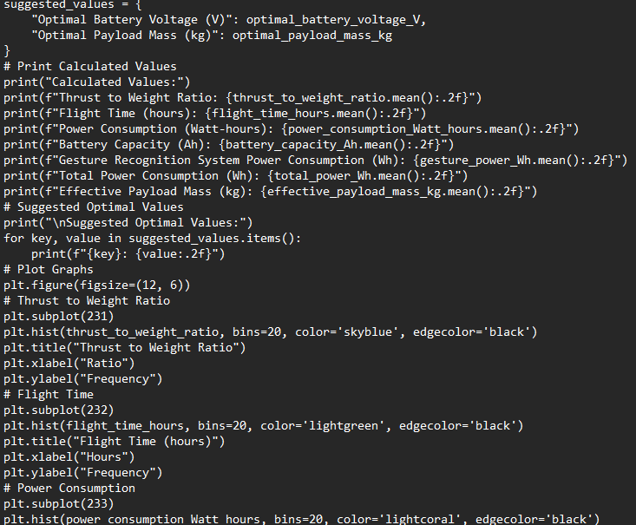
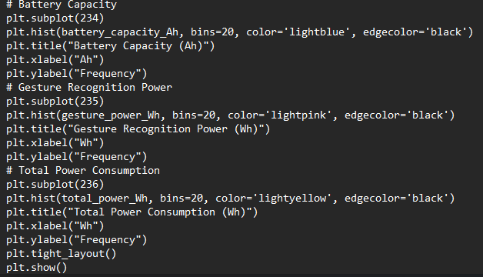
AIML ANALYSIS MODEL – JUPYTER NOTEBOOK

Slide 3
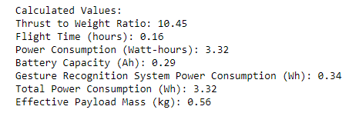
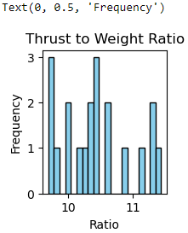
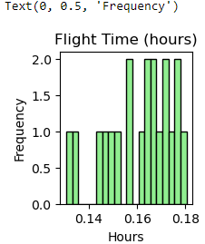
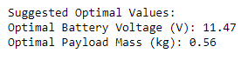
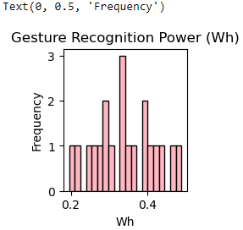
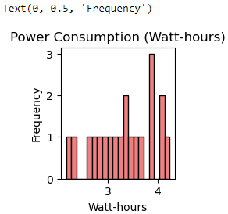
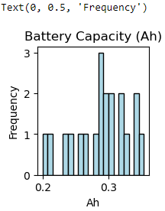
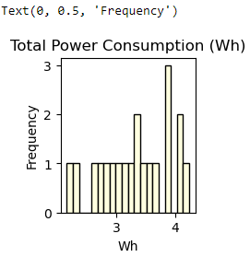
AIML MODEL OUTPUTS

Slide 4
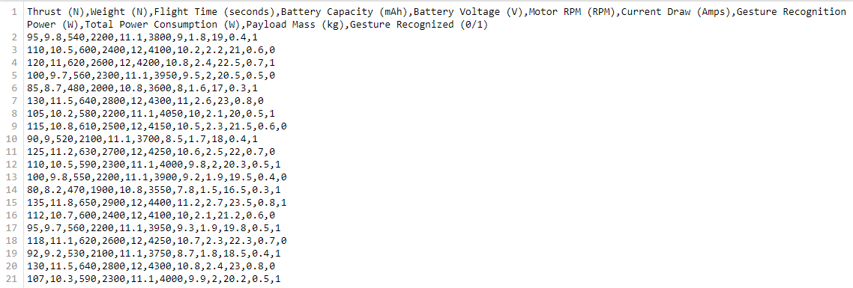
DATA USED IN THE MODEL – CSV FILE

Slide 5
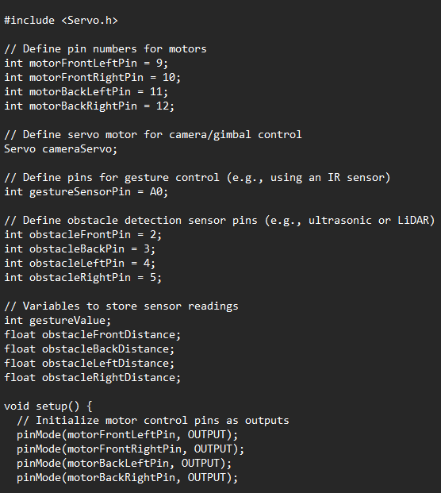
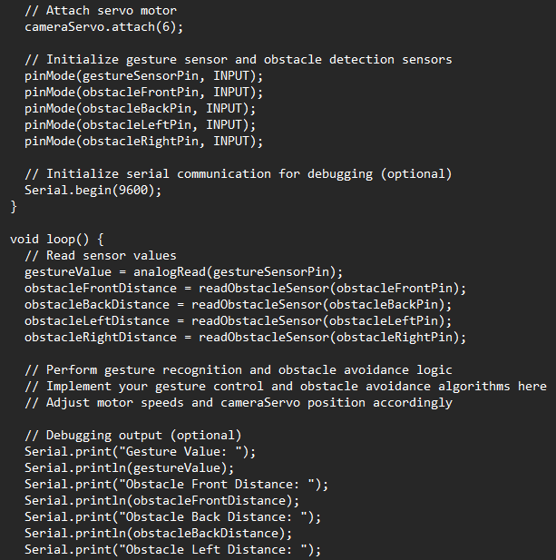
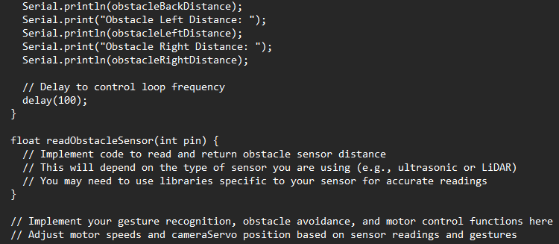
GESTURE CONTROL PROGRAM – ARDUINO IDE

Slide 6
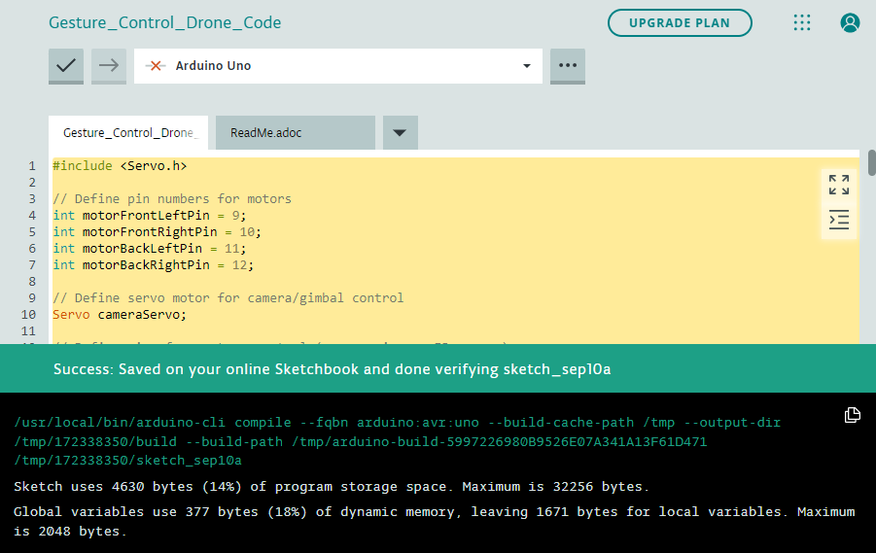
GESTURE CONTROL PROGRAM – OUTPUT

Slide 7
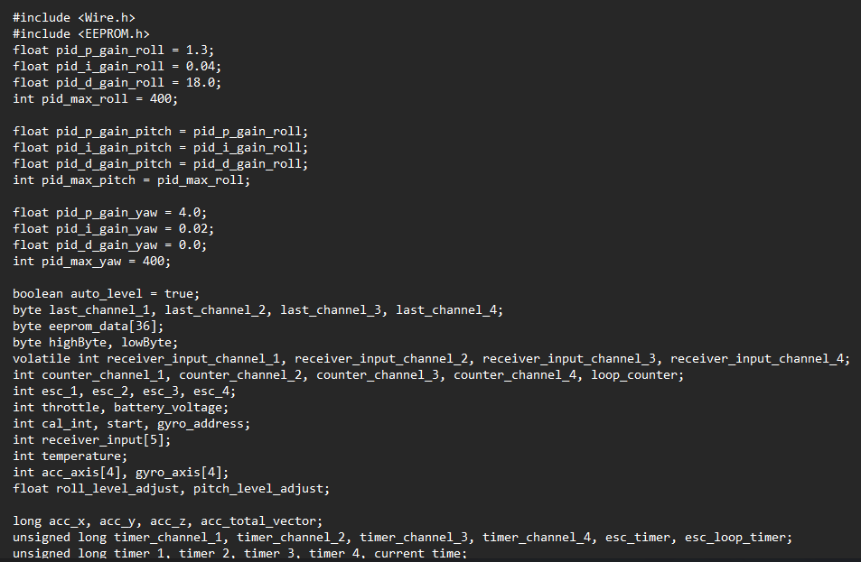
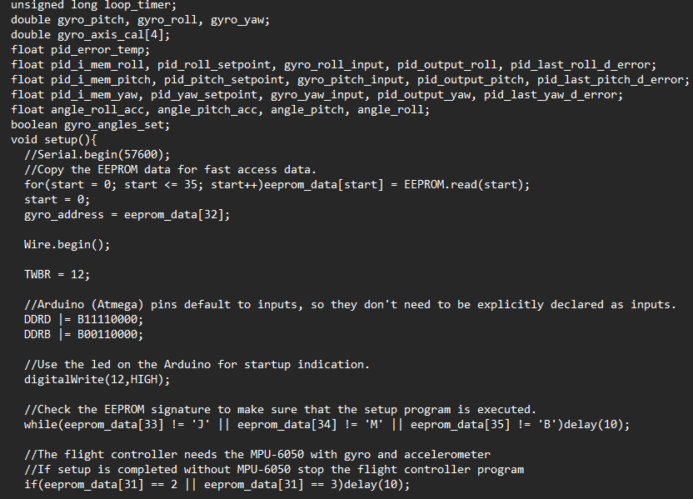
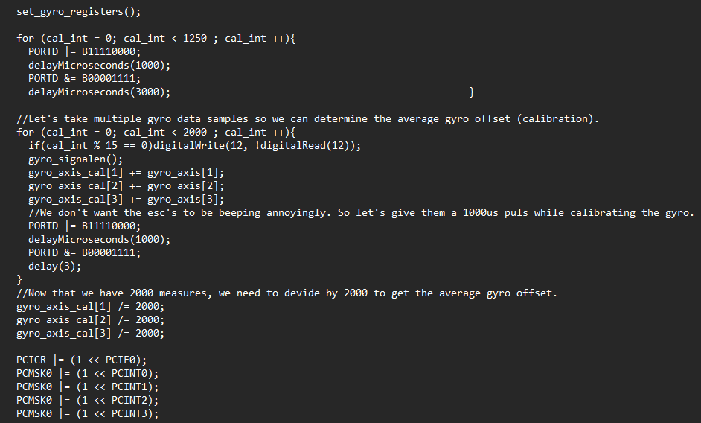
GENERAL FLIGHT CONTROLLER CODE – ARDUINO IDE [OPTIONAL]

Slide 8
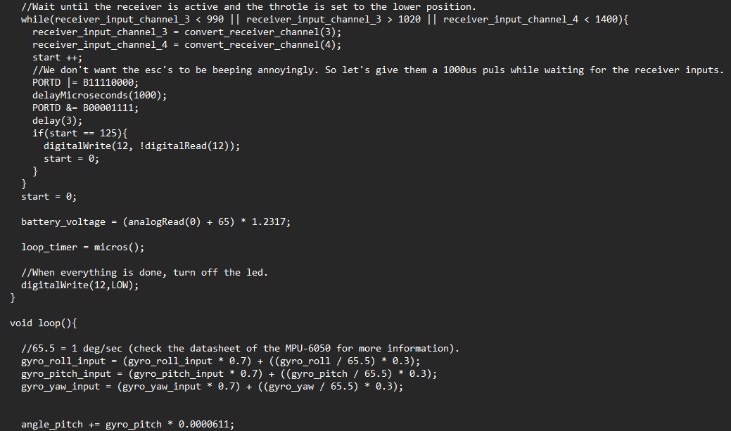
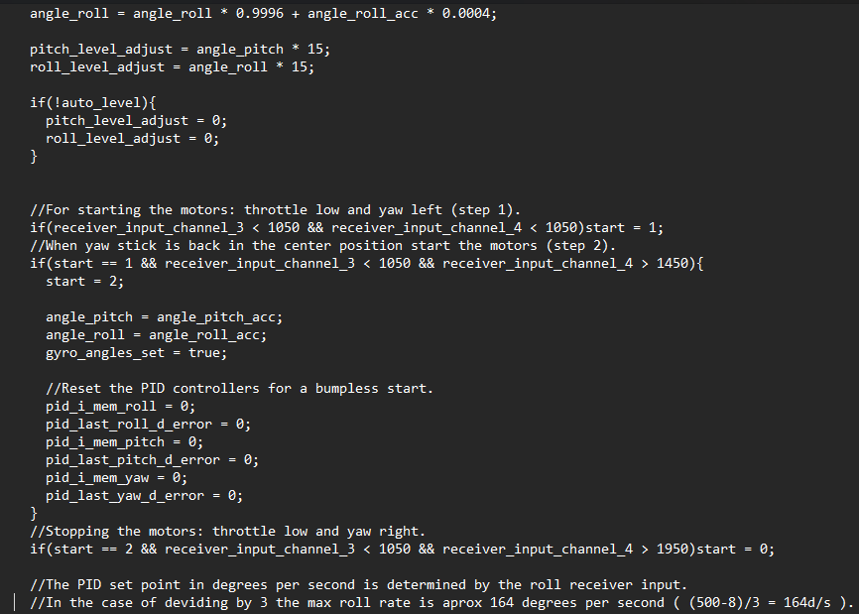
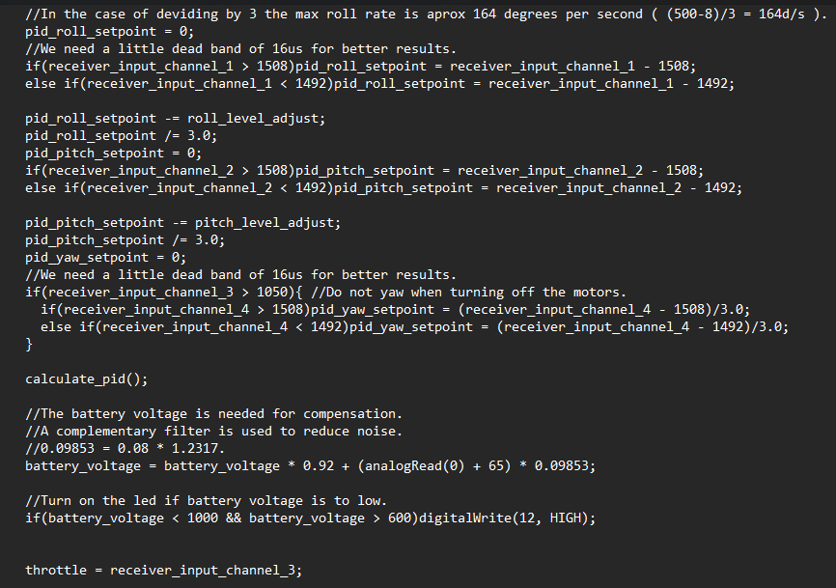
GENERAL FLIGHT CONTROLLER CODE – ARDUINO IDE [OPTIONAL]

Slide 9
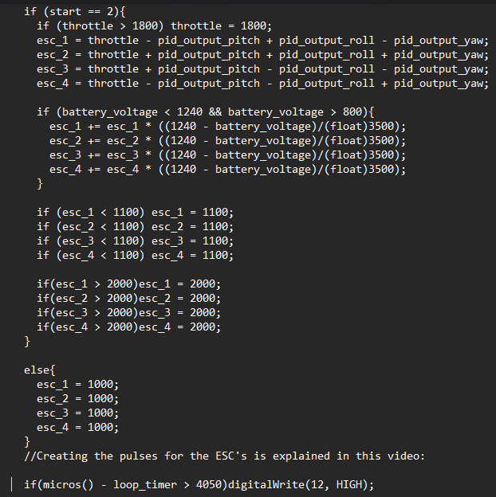
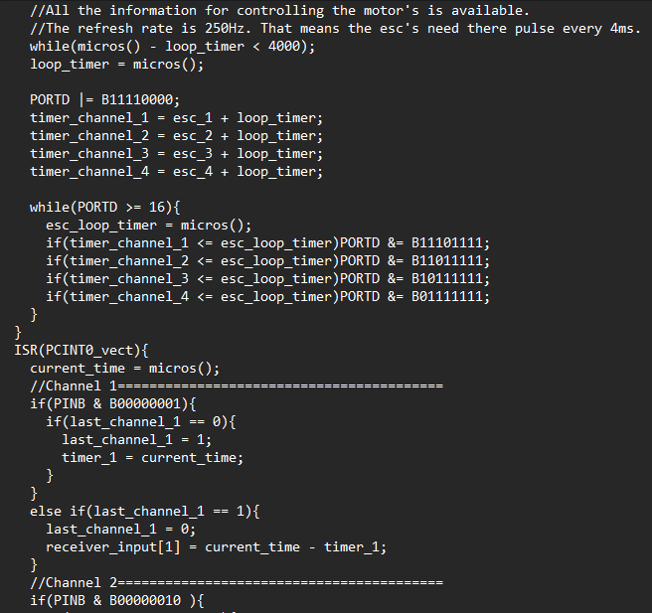
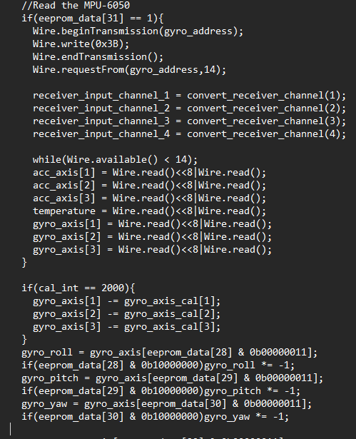
GENERAL FLIGHT CONTROLLER CODE – ARDUINO IDE [OPTIONAL]

Slide 10
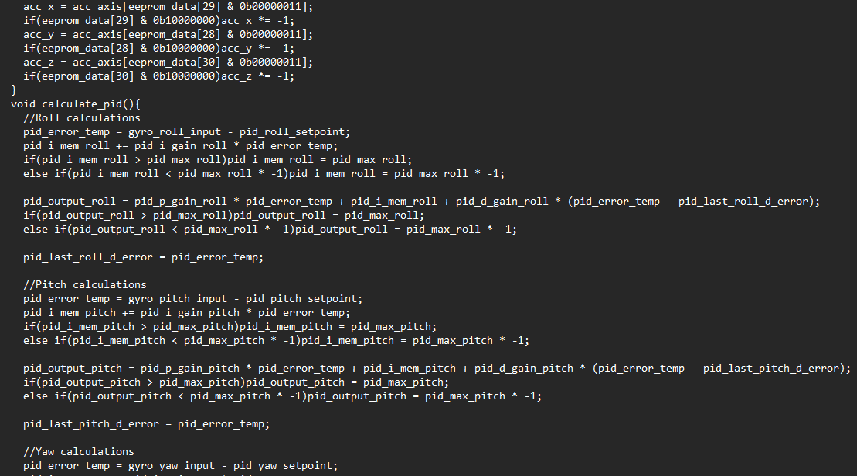
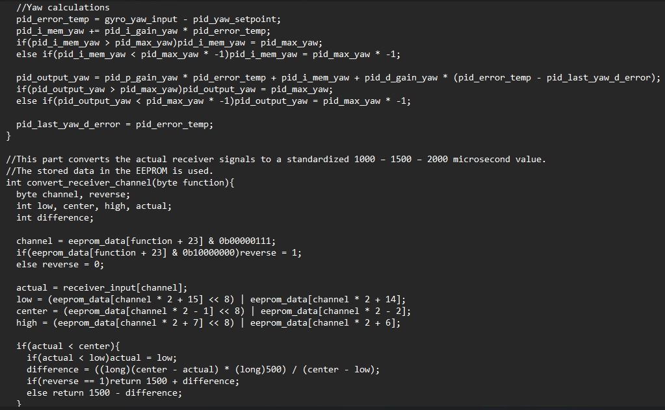
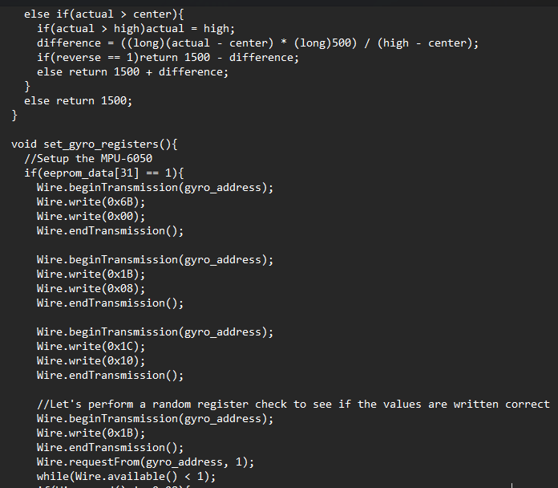
GENERAL FLIGHT CONTROLLER CODE – ARDUINO IDE [OPTIONAL]

Slide 11
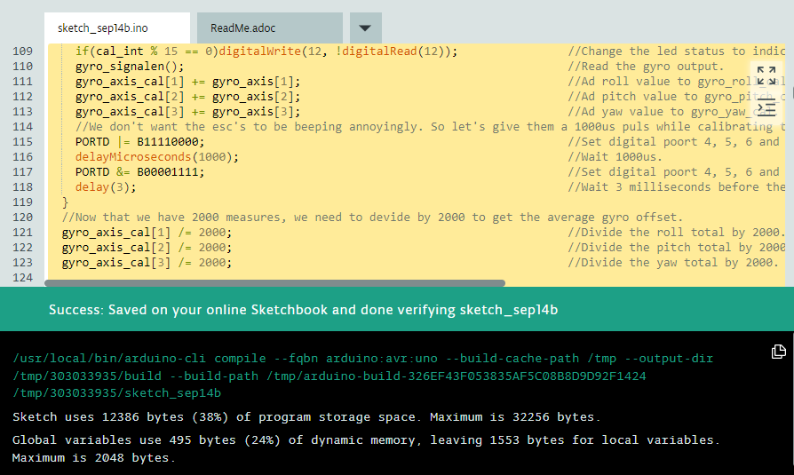
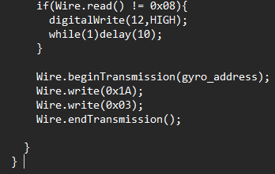
GENERAL FLIGHT CONTROLLER CODE & result – ARDUINO IDE [OPTIONAL]

Slide 12
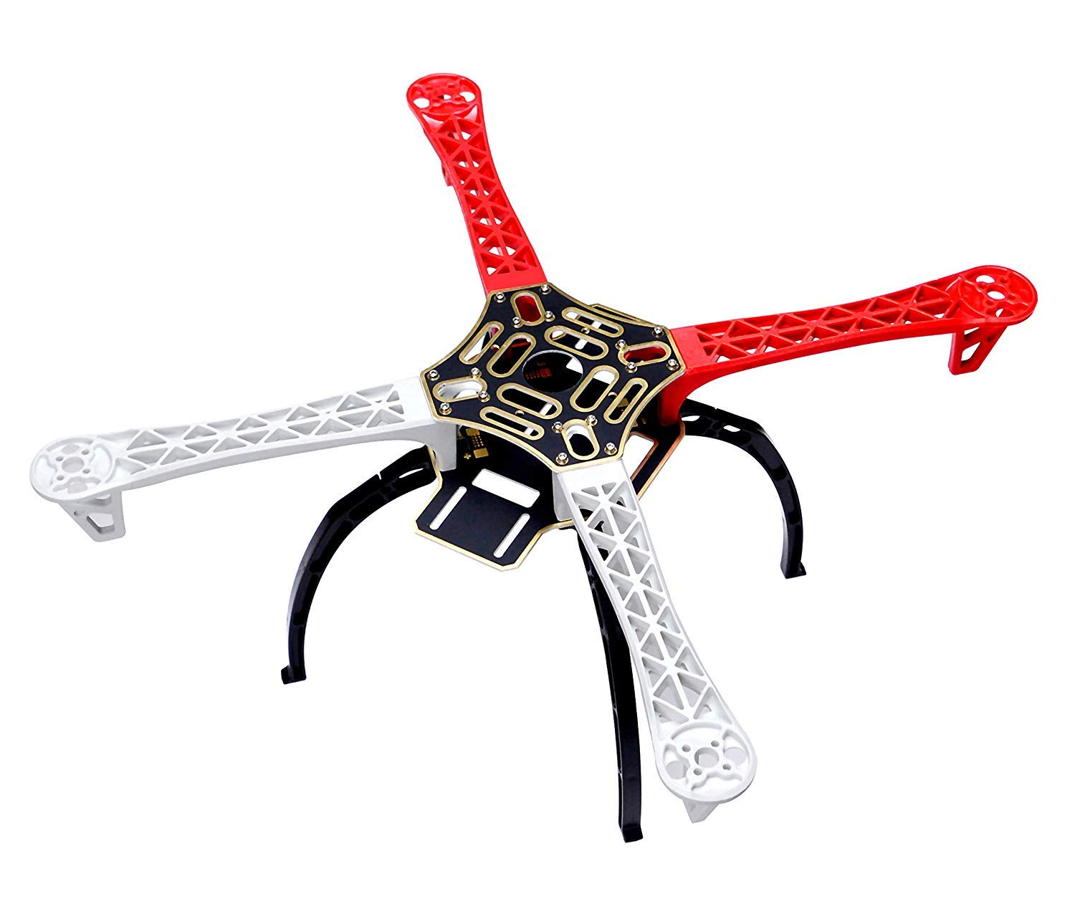
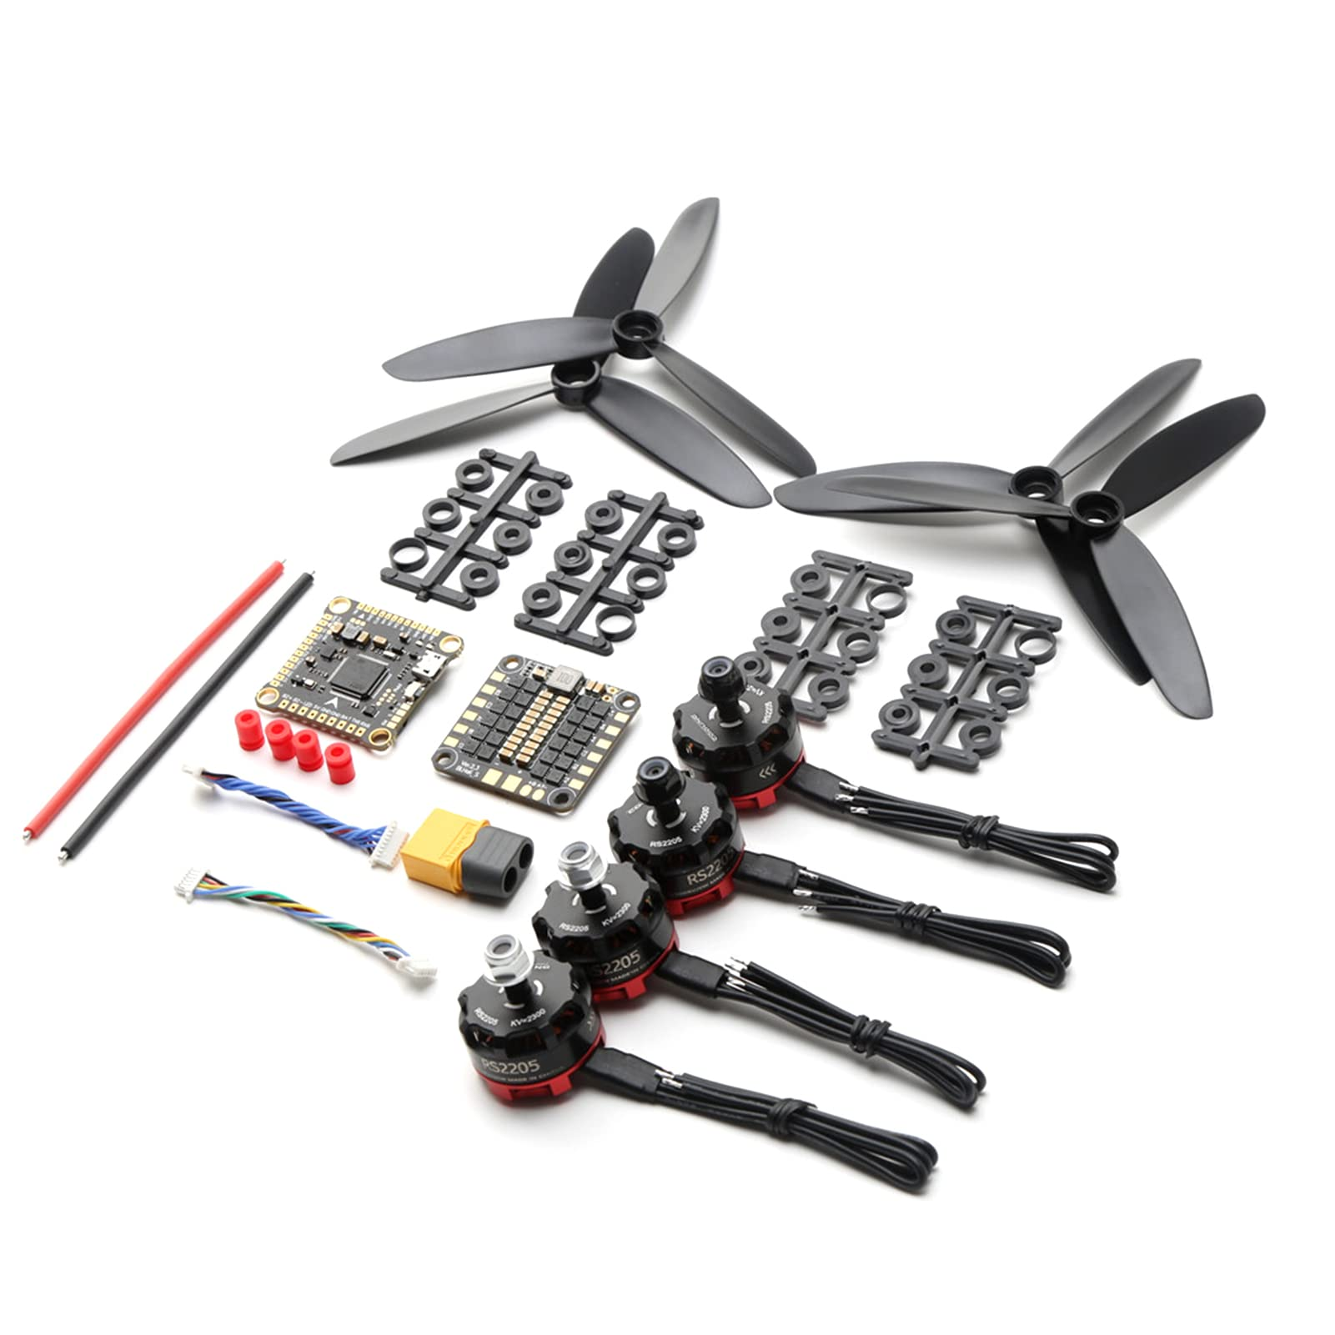
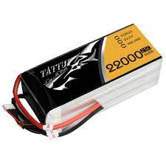
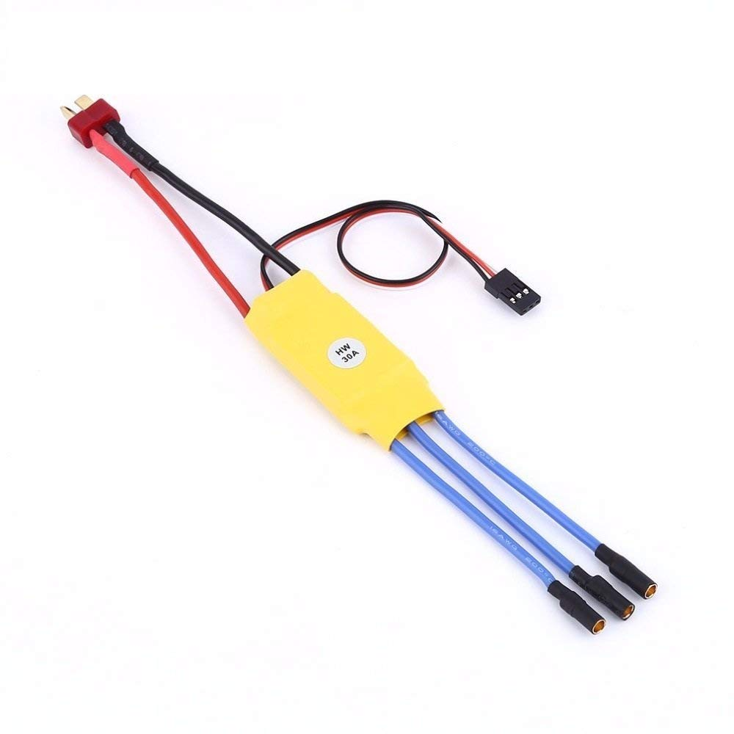
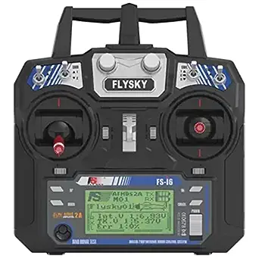
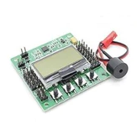
PARTS TO BE USED
Motors, Propellers, Wires.
Battery
ESC
Drone Frame
Flight Controller
Radio Controller

Slide 13
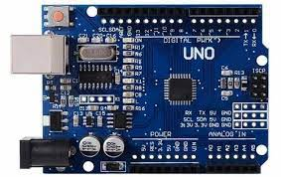
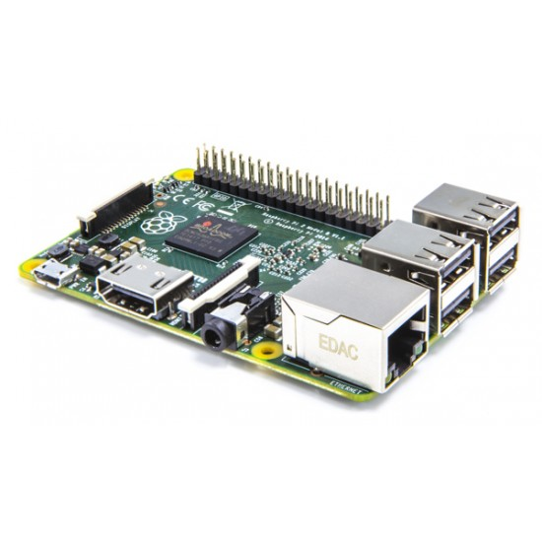
IOT COMPONENTS USED
ARDUINO BOARD
RASPERRY PI

Slide 14
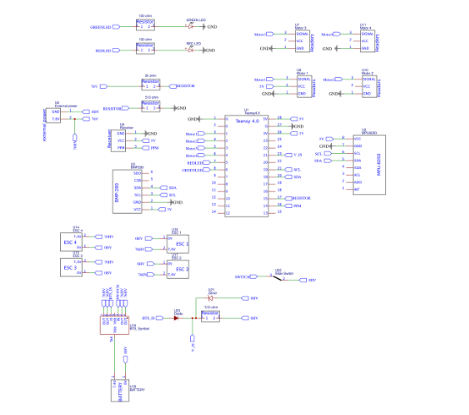
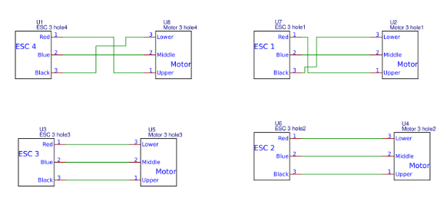
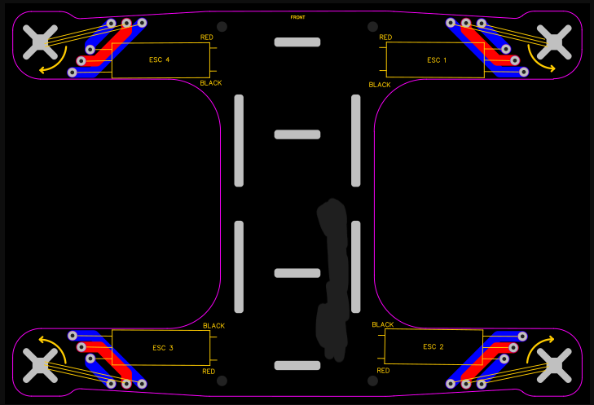
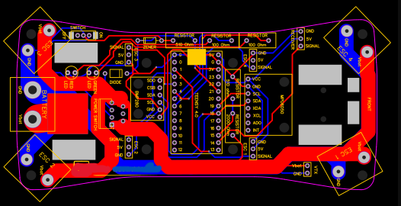
DRONE BASIC CIRCUIT DESIGNS - CONNECTIONS
LOWER DRONE FRAME
UPPER DRONE FRAME
LOWER DRONE FRAME – PCB
UPPER DRONE FRAME – PCB

Slide 15
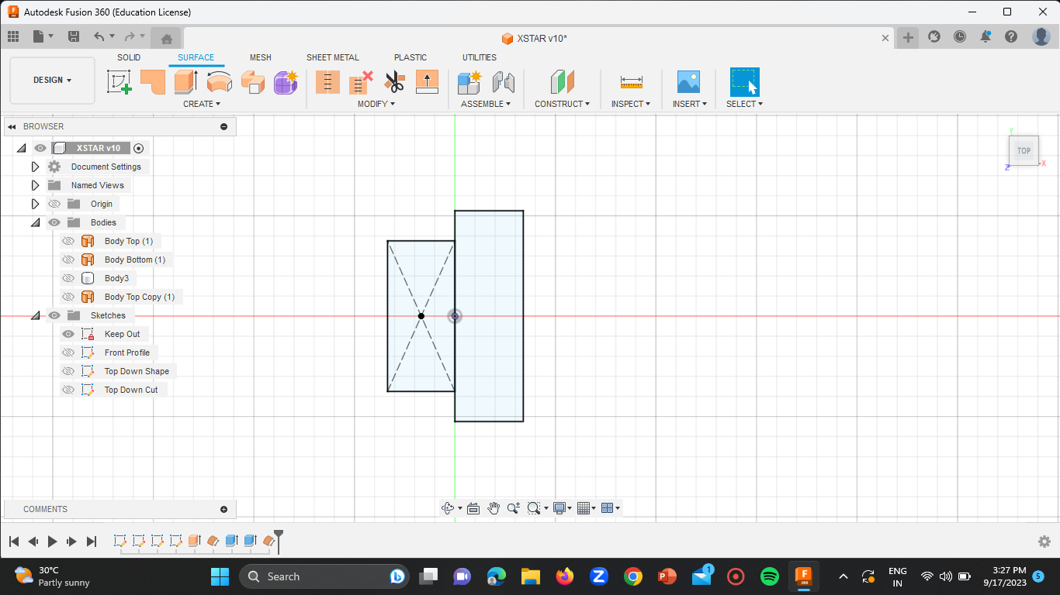
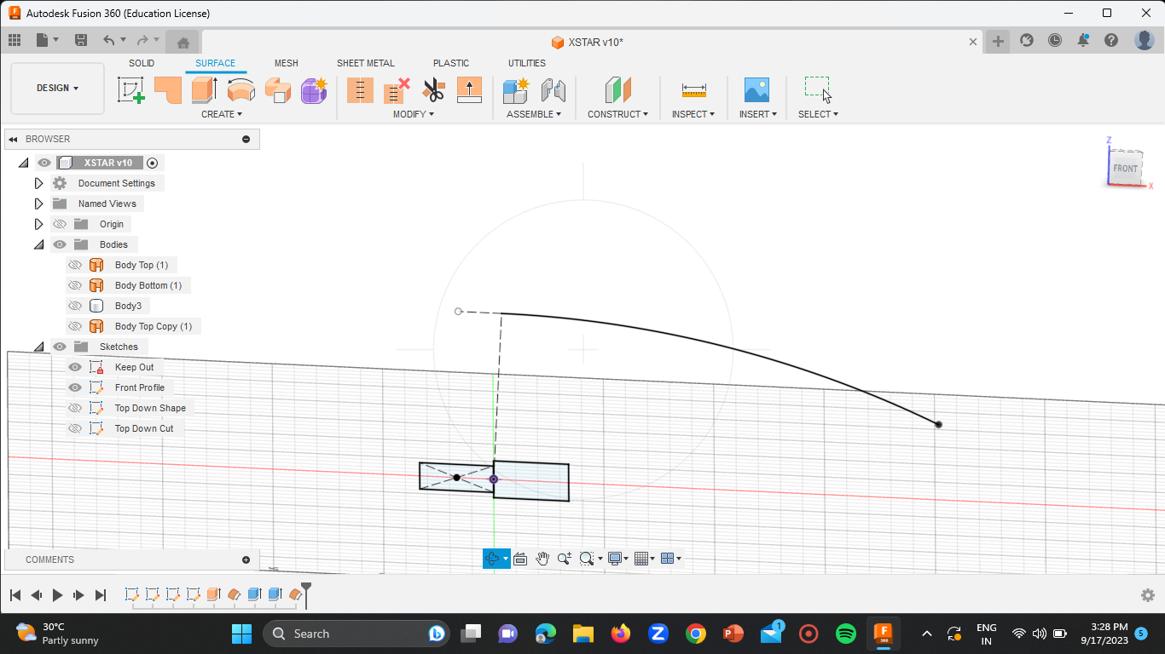
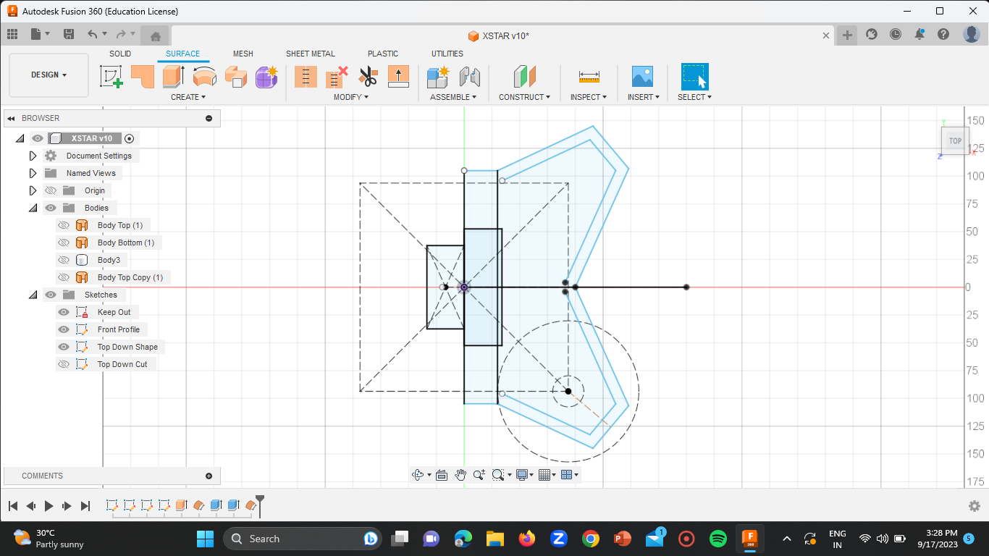
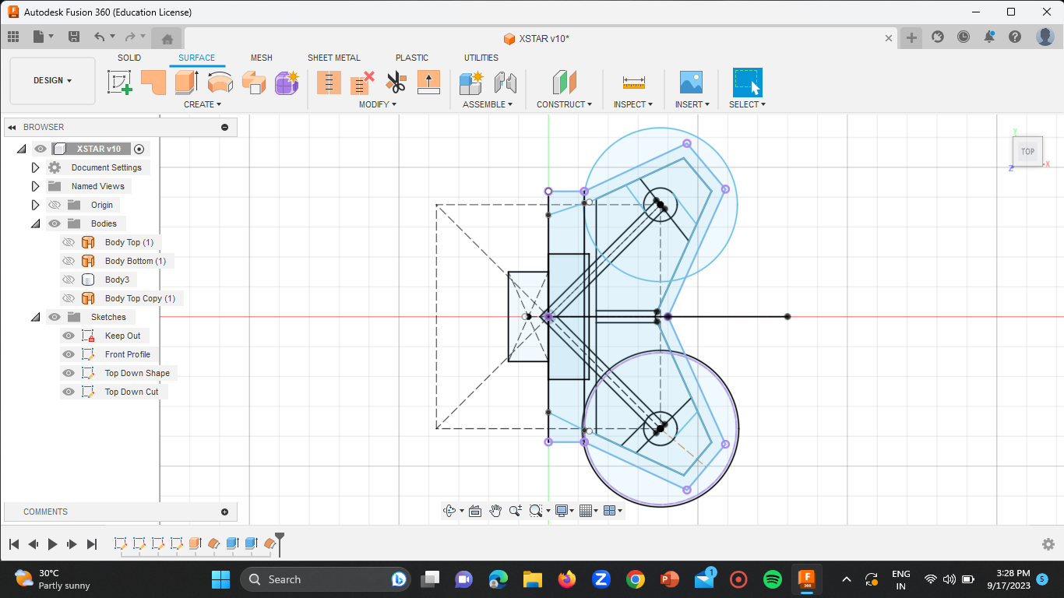
DESIGN – DRONE FRAME [FUSION 360]
Battery – Keep Out
Front Profile
Top – Down Shape
Top – Down Cut

Slide 16
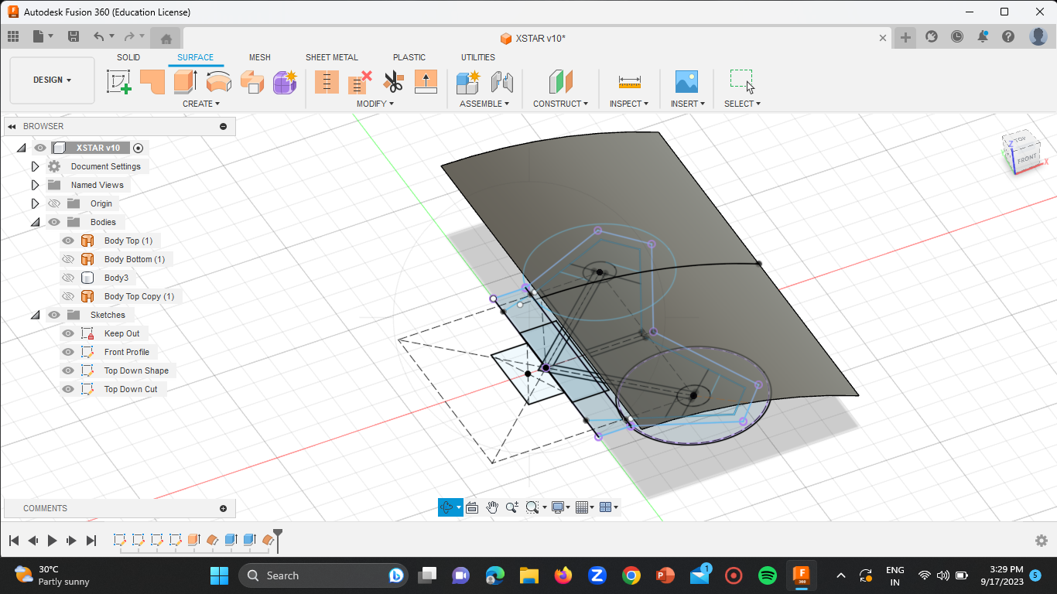
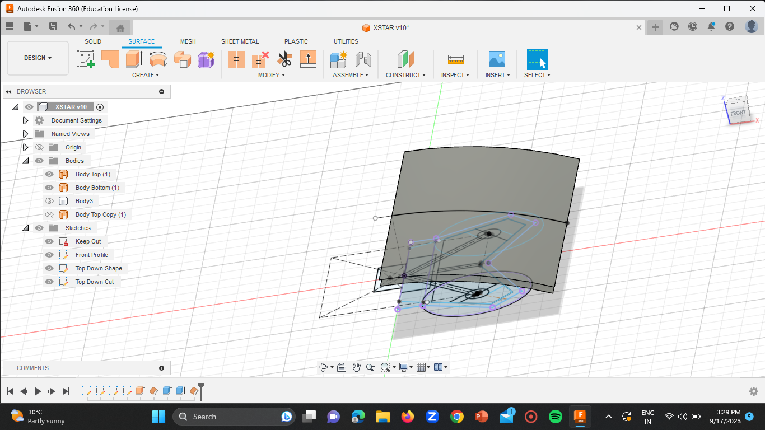
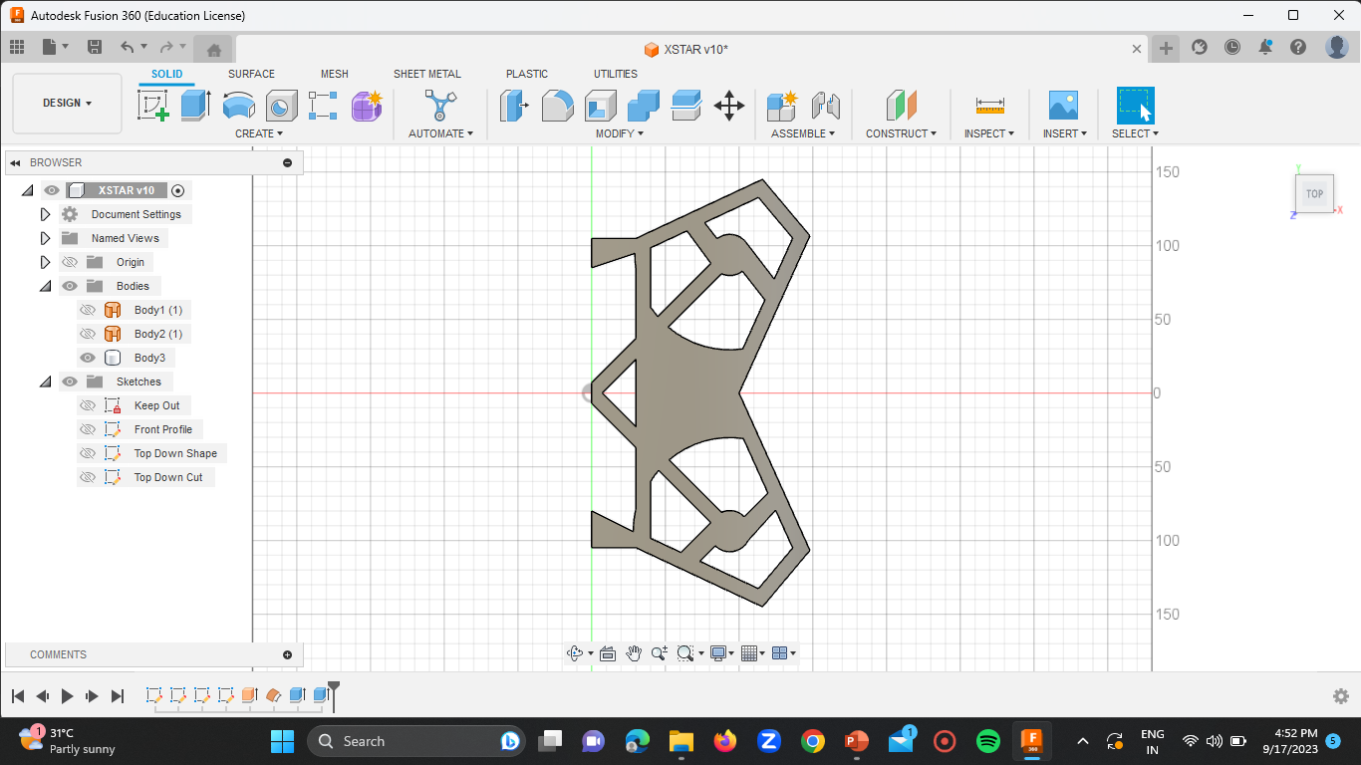
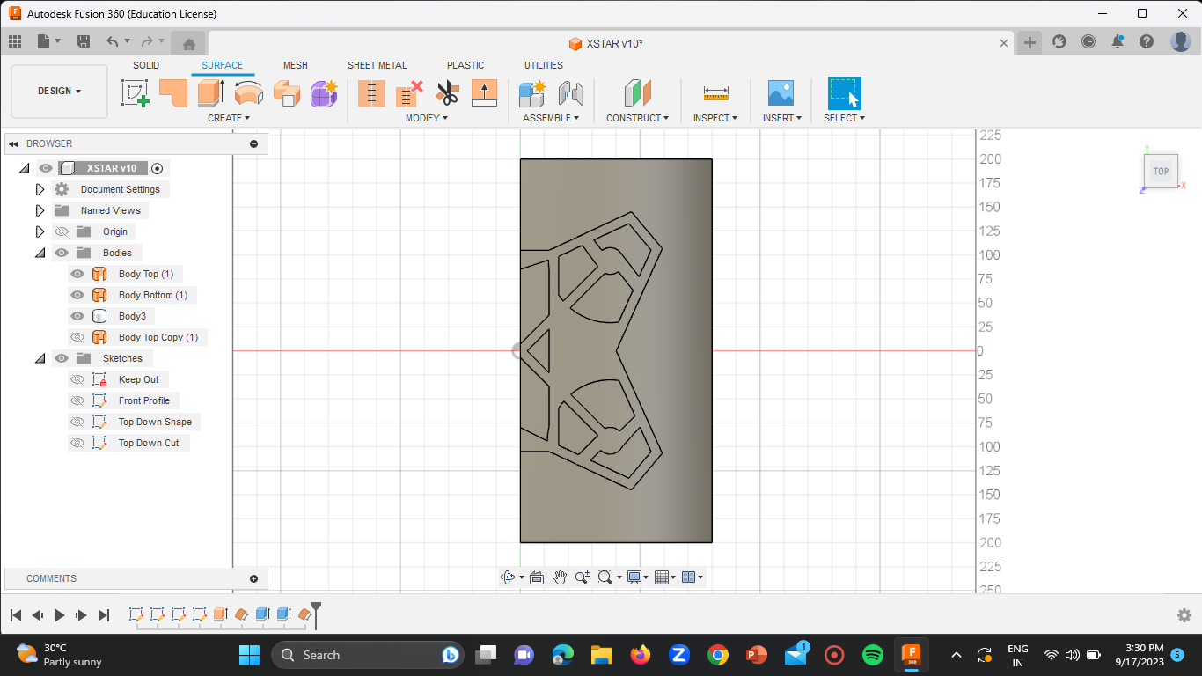

DESIGN – DRONE FRAME [FUSION 360]

Slide 17



CALCULATIONS

Slide 18

THANK YOU

